Slide 1



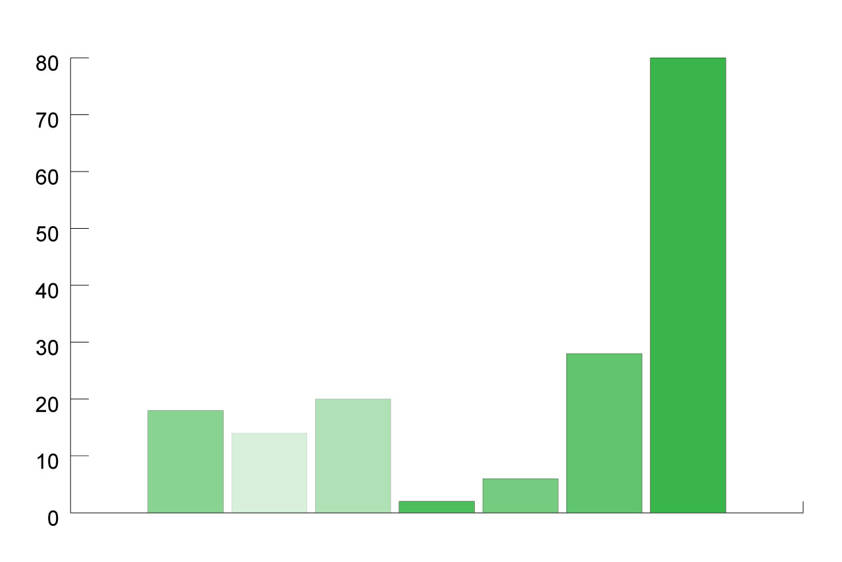

Design and nam molestie tortor quis pretium vulputate. Cras dolor nisl, consectetur et tincidunt sed, tincidunt in lorem.
Lead Author†, Author Name†, Author Name†, Author Name†, Author Name†,
Author Name§,
† Information can go here | § Information can go here
Insert your section title
‘they walked off together, Alice heard the King say in a low voice, to the company generally, 'You are all pardoned.' 'Come, THAT'S a good thing!' she said to herself, for she had felt quite unhappy at the number of executions the Queen had ordered.
They very soon came upon a Gryphon, lying fast asleep in the sun. (IF you don't know what a Gryphon is, look at the picture.) 'Up, lazy thing!' said the Queen, 'and take this young lady to see the Mock Turtle, and to hear his history. I must go back and see after some executions I have ordered'; and she walked off, leaving Alice alone with the Gryphon. Alice did not quite like the look of the creature, but on the whole she thought it would be quite as safe to stay with it as to go after that savage Queen: so she waited.
The Gryphon sat up and rubbed its eyes: then it watched the Queen till she was out of sight: then it chuckled. 'What fun!' said the Gryphon, half to itself, half to Alice.
Insert your section title
‘they walked off together, Alice heard the King say in a low voice, to the company generally, 'You are all pardoned.' 'Come, THAT'S a good thing!' she said to herself, for she had felt quite unhappy at the number of executions the Queen had ordered.
They very soon came upon a Gryphon, lying fast asleep in the sun. (IF you don't know what a Gryphon is, look at the picture.) 'Up, lazy thing!' said the Queen, 'and take this young lady to see the Mock Turtle, and to hear his history. I must go back and see after some executions I have ordered'; and she walked off, leaving Alice alone with the Gryphon. Alice did not quite like the look of the creature, but on the whole she thought it would be quite as safe to stay with it as to go after that savage Queen: so she waited.
The Gryphon sat up and rubbed its eyes: then it watched the Queen till she was out of sight: then it chuckled. 'What fun!' said the Gryphon, half to itself, half to Alice.
Insert your section title
‘they walked off together, Alice heard the King say in a low voice, to the company generally, 'You are all pardoned.
Insert your section title
‘they walked off together, Alice heard the King say in a low voice, to the company generally, 'You are all pardoned.
Table 1 | Table 2 | Table 3 | Table 4
Data | Data | Data | Data
 | Data | Data | Data
 | Data | Data
Insert your section title
‘they walked off together, Alice heard the King say in a low voice, to the company generally, 'You are all pardoned.
The Gryphon sat up and rubbed its eyes: then it watched the Queen till she was out of sight: then it chuckled.
Table 1 | Table 2 | Table 3 | Table 4
Data | Data | Data | Data
 | Data | Data | Data
 | Data | Data
Summary and conclusions
‘they walked off together, Alice heard the King say in a low voice, to the company generally, 'You are all pardoned.' 'Come, THAT'S a good thing!' she said to herself, for she had felt quite unhappy at the number of executions the Queen had ordered.
Key finding number 1
Key finding number 2
Key finding number 3
Key finding number 4
‘they walked off together, Alice heard the King say in a low voice, to the company generally,
The Gryphon sat up and rubbed its eyes: then it watched the Queen till she was out of sight: then it chuckled.
‘they walked off together, Alice heard the King say in a low voice, to the company generally, 'You are all pardoned.
Funding provided by the
Government of Ontario.

